Slide 1
Chapter 10
Place and Development of Channel Systems
Notes:
For use only with Perreault/Cannon/McCarthy.
© 2019 McGraw-Hill Companies, Inc.
CHAPTER TEN
Lecture Notes for
Essentials of Marketing 16e

Slide 2
At the end of this presentation, you should be able to:
understand what product classes suggest about Place objectives.
understand why some firms use direct channel systems while others work with intermediaries and indirect systems.
understand how and why marketing specialists develop to make channel systems more effective.
understand how to develop cooperative relationships and avoid conflict in channel systems.
know how to channel members in vertical marketing systems shift and share functions
to meet customer needs.
Notes:
At the end of this presentation, you should:
1. understand what product classes suggest about Place objectives.
2. understand why some firms use direct channel systems while others work with intermediaries and indirect systems.
3. understand how and why marketing specialists develop to make channel systems more effective.
4. understand how to develop cooperative relationships and avoid conflict in channel systems.
5. know how to channel members in vertical marketing systems shift and share functions to meet customer needs.

Slide 3
At the end of this presentation, you should be able to:
understand the differences between intensive, selective, and exclusive distribution.
know how multichannel distribution and reverse channels operate.
know the main approaches firms use to reach customers in international markets.
understand important new terms.
Notes:
At the end of this presentation, you should be able to:
understand the differences between intensive, selective, and exclusive distribution.
know how multichannel distribution and reverse channels operate.
know the main approaches firms use to reach customers in international markets.
understand important new terms.

Slide 4
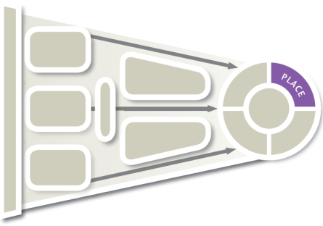
Marketing Strategy Planning Decisions for Place (Exhibit 10-1)
CH 10: Place and Development of Channel Systems
CH 11: Distribution Customer Service and Logistics
CH 12: Retailers, Wholesalers and Their Strategy Planning
Place objectives
Direct vs. indirect
Channel specialists
Channel relationships
Other decisions
Notes:
Summary Overview
Place is the part of the marketing mix that deals with making goods and services available in the right quantities and locations when customers want them.
Key Issues
This is the first of three chapters that will examine Place.
Channel of distribution: Any series of firms or individuals participating in the flow of products from producer to final user or consumer. Among the key strategy decision areas in distribution are:
The organization must develop objectives for Place.
There must be a choice of the type of channels, such as direct-to-customer, or indirect—involving intermediaries.
Channel specialists create value by helping firms deal with discrepancies and assortments through regrouping activities.
We will also consider different types of channel relationships and
Other strategy decisions including how much exposure to have in the market, when to use more than one channel for a particular target market, reverse channels of distribution when products need to be recycled or returned and international market entry.
After this chapter we will look more closely at customer service and logistics in Chapter 11 and then the strategy planning for retailers and wholesalers in Chapter 12.
Discussion Question: It is often said that unlike the other elements of the marketing mix, distribution is mostly invisible to consumers unless something goes wrong. What does this statement mean?

Slide 5
Place Decisions Are Guided by “Ideal” Place Objectives
Product
Classes
Suggest Place
Objectives
Key
Issues
Place
System
Is Not
Automatic
Place Decisions
Have Long-run Effects
Notes:
Summary Overview
Customers may have different needs with respect to time, place, and possession as they make different purchases.
Key Issues
Product classes suggest place objectives.
Different levels of customer urgency, convenience, and product information needs naturally suggest different place needs as well.
Discussion Question: Think about the differences among convenience, shopping, and specialty goods. How would the distribution objectives differ for each product type?
→ The place system is not automatic.
More than one place arrangement may be appropriate or needed to reach different target markets effectively.
→ Place decisions have long-run effects, and are usually harder to change than those made for the other components of the mix.
In part, this is because other firms in the channel of distribution may carry out much of the place strategy.
Gaining access to desired retail space or outlets typically involves a great deal of time and then is bound by contractual arrangements.

Slide 6
Channel System May Be
Direct or Indirect
Greater Control
Some Reasons
For Choosing
Direct Channels
Lower Cost
Internet Makes Direct Distribution Easier
Direct Contact with Customers
No Suitable Intermediaries
Notes:
Summary Overview
Marketing channels can be direct or indirect. Direct contact with customers helps a company keep abreast of market changes. Often, this is a preferred way of handling place decisions. However, some products require the work of specialists to match producer output to user needs.
Key Issues
Why a firm might want to use direct distribution:
To get better control over the whole marketing job.
→ They might be able to serve target customers at a lower cost. Also, wholesalers and retailers with different objectives may not meet the firm's need.
The Internet makes direct distribution easier for many firms.
Discussion Question: If direct distribution is so attractive because of the wide reach of the Internet, why have so many dot-com direct distributors failed?
→ A firm having direct contact with customers is more aware of changes in customer attitudes.
→ Making adjustments is often easier and faster because intermediaries are not involved.
→ Sometimes, suitable intermediaries are not available or will not cooperate.

Slide 7

Direct Channels Are Common
Source: Girl Scouts Cookie Finder App; smartphone frame: ©Oleg GawriloFF/Shutterstock RF
Notes:
Text Caption: See below
Summary Overview
Many products are sold direct-to-customer. For example, the cookies sold by Girl Scouts, featured in this ad, might be sold direct.
Key Issues
Girls Scouts sell their cookies direct to customers; but one needs to know when and where a girl scout will be selling the cookies.
So, they created the Cookie Locator app for the iPhone.
Customers just enter their zip code and they will be directed to the nearest source of the tasty treats.
Discussion Question: Mary Kay cosmetics are typically sold through independent distributors who are not employees of Mary Kay Cosmetics, Inc. These independent distributors purchase products from Mary Kay and resell them. Therefore, is Mary Kay a true direct channel?
Direct marketing: Direct communication between a seller and an individual using a promotion method other than face-to-face selling.
Direct marketing is more concerned with promotion than it is with distribution.

Slide 8
When Indirect Channels Are Best
Convenience
Store loyalty
Lower initial investments
Notes:
Summary Overview
Even if a producer would like to handle the whole distribution job, sometimes it is simply not feasible.
Key Issues
Some target markets place a high value on convenience.
In some product categories, customers trust a particular outlet to meet their needs. They are loyal. For instance, some customers only shop at Best Buy for TVs.
Indirect channels usually require less investment dollars.
Selling direct can involve significant investments in facilities like warehouses, retail stores, and information technology.
While Nike sells some of its shoes direct, why are most purchased through retail stores?
Indicates place where slide “builds” to include the corresponding point (upon mouse click).

Slide 9
Checking Your Knowledge
Andrea’s Kitchen is a catering business that operates by means of its own website. Customers order party platters, pastries, and other foods that the company makes to order. The items are then vacuum-packed in dry ice and shipped to the customer’s address via overnight delivery. Andrea’s Kitchen is part of a(n):
A. indirect channel.
B. dual channel.
C. intermediary channel.
D. direct channel.
E. traditional channel.
Notes:
Checking Your Knowledge
Answer: D
Feedback: Web-based e-commerce systems give many firms direct access to customers. This website allows customers to place orders and provide information so that Andrea’s Kitchen can ship directly to them. Andrea’s Kitchen is an example of a direct channel. The best answer selection is D.

Slide 10
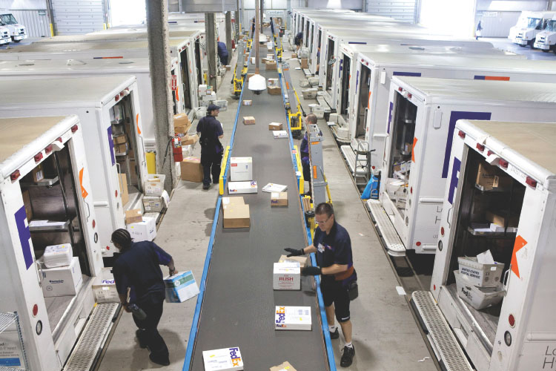
Channel Specialists May Reduce Discrepancies and Separations
©Photo by Reed/Bloomberg via Getty Images
Notes:
Text Caption: See below.
Summary Overview
The assortment and quantity of products consumers desire may be different than the assortment and quantity of products offered by producers. Considerable distances may separate producers and consumers. Customers may not be adequately informed about product choices. Channel specialists have evolved to deal with these market separations and discrepancies.
Key Issues
Intermediaries may supply needed information to consumers and bring buyers together with sellers.
Intermediaries can take advantage of their understanding of customers to predict consumer needs and develop accurate demand forecasts.
This information can reduce channel costs, smooth out production runs, and permit easier access to international markets.
Intermediaries can help to rectify discrepancies of quantity and assortment.
Discrepancy of quantity: The difference between the quantity of products it is economical for a producer to make and the quantity that consumers or users really want.
As shown in this ad, FedEx offers specialized services that facilitate exchange between producers and consumers, it helps to reduce discrepancies and separations.

Slide 11

Channel Specialists Adjust Discrepancies with Regrouping Activities
Accumulating
Bulk-Breaking
Assorting
Sorting
© Cultura Creative (RF) / Alamy
Notes:
Summary Overview
Regrouping activities are activities that adjust discrepancies in quantity or assortment.
Key Issues
Channel specialists adjust quantity discrepancies by accumulating and bulk-breaking.
Accumulating: Collecting products from many small producers.
Bulk-breaking: Dividing larger quantities into smaller quantities. Several levels of a channel may be involved.
Discussion Question: When consumers purchase household products from a warehouse store, such as Costco or Sam’s Club, they often have to buy larger quantities than they would normally buy for their immediate use. How are they compensated for taking on some of the bulk-breaking that a traditional retailer might provide?
Wholesalers and retailers adjust assortment discrepancies by sorting and assorting.
→ Sorting: Separating products into the grades and qualities desired by consumers.
→ Assorting: Putting together a variety of products to give a target market what it wants.
Even without a physical form, distribution remains an important marketing strategy decision for firms with digital products.
It is important for marketers to watch for changes needed in assortments and quantities as consumer needs change, or as the marketing environment shifts.
→ Indicates place where slide “builds” to include the corresponding point (upon mouse click).

Slide 12
Channel Relationships Must Be Managed
Choosing the Type of Relationship
Key
Issues in
Channel
Management
Whole-Channel Product-Market Commitment
Conflict Handling
Role of Channel Captain
Notes:
Summary Overview
Just as intermediaries are specialists in certain areas, they are also separate businesses that may not have the same objectives as the marketer of the product.
Key Issues
The marketing manager must choose the type of channel system to join or develop.
The whole channel should have a product-market commitment. All members must focus on the same target market at the end of the channel and share the various marketing functions in appropriate ways.
Discussion Question: How might a producer generate a common product-market commitment among all channel members?
Traditional channel system: members make little or no effort to cooperate with each other.
→ Channel specialization can lead to conflict that gets in the way.
Vertical conflict is conflict between two firms at different levels in the channel of distribution, as between a producer and wholesaler.
Horizontal conflict occurs between two firms at the same level in the channel of distribution, such as two retailers.
Managing channel conflict: Some level of conflict is inevitable—or even useful if that is what it takes for customers at the end of the channel to receive better value.
Most marketing managers try to avoid conflicts that harm relationships with channel partners.
Channel captain: A manager who guides channel relationships. The captain helps direct the activities of the whole channel and tries to avoid or resolve channel conflicts.
→ Indicates place where slide “builds” to include the corresponding point (upon mouse click).

Slide 13
How Channel Functions May Be Shifted and Shared in Different Channel Systems(Exhibit 10-3)
A. How strategy decisions are handled
in a producer-led channel
B. How strategy decisions are handled
in a retailer-led channel
Producer’s
part of
the job
Intermediary’s
part of
the job
Producer’s
part of
the job
Retailer’s
part of
the job
Place
Product
Product
Place
Customers
Customers
Price
Price
Promotion
Promotion
Notes:
Summary Overview
Although producers typically have leadership positions in channels of distribution, powerful intermediaries may also serve as channel captains. In recent years, it has become more popular for intermediaries to take on this role.
Key Issues
This exhibit illustrates an example of how a producer-led channel might operate.
The producer develops the product and the price structure but relies mainly on intermediaries to help with distribution and promotion.
→ Wholesalers or retailers might also be channel captains, either because of their size or their proximity to consumers.
In this case, the intermediary takes on all of the place and promotion functions, and part of the pricing and product functions.
A retailer or wholesaler might get involved with the product and pricing by developing dealer brands.
When intermediaries are large and wield channel power because of their size, they can influence the structure and processes in the channel.
Large retailers buy in such large volume from producers that they often bypass wholesalers and deal with the producers directly.
Large retailers also secure volume discounts from producers.
→ Indicates place where slide “builds” to include the corresponding point (upon mouse click).

Slide 14
Characteristics of Traditional and Vertical Marketing Systems(Exhibit 10-3)
Characteristics
Type of channel
Traditional
Vertical marketing systems
Administered
Contractual
Corporate
Amount of cooperation
Little or
none
Some to good
Fairly good
to good
Complete
Control
maintained by
None
Economic power and leadership
Contracts
One company ownership
Examples
Typical “inde-pendents”
General Electric
McDonald’s
Florsheim
Notes:
Summary Overview
Compared to a traditional channel, in a vertical marketing system, the whole channel focuses on the same target market at the end of the channel.
Key Issues
→ Corporate channel system: Characterized by the ownership of each level of the channel by the same corporation, giving the appearance that the firm is going direct.
Vertical integration: The buying of other firms by one member of the channel. Any level of the channel may become the acquiring corporation.
→ Administered channel system: Channel members informally agree to cooperate with each other. Such agreements typically cover procedures to routinize ordering, standardize accounting, and coordinate promotion efforts.
Discussion Question: Do you think there might be the potential for a channel captain to emerge in an administered system? Why or why not?
→ Contractual channel system: Channel members formally agree to cooperate via contracts. Many popular franchise systems are examples of contractual channels.
Vertical marketing systems are a dominant force in the marketplace. In fact, they capture a majority of retail sales and should increase their share in the future.
→ Indicates place where slide “builds” to include the corresponding point (upon mouse click).

Slide 15

Channel Relationships
Click on play button to view video
Notes:
This video clip highlights the concepts of channel captain and administered channel system with an example from Briggs & Stratton.
(video clip length 2:18)
Video Operation:
INTERNET CONNECTION REQUIRED
Clicking on the orange circle image will open a web browser and access this video. When the video is completed, you can close or minimize the browser and return to the PowerPoint slides.

Slide 16
Checking Your Knowledge
Dave Tindall runs “Maid to Perfection,” a residential and business cleaning service. He paid a fee to be part of the “Maid to Perfection” system of local operators. The written agreement gives him the right to use the company name and operations manual, and the agreement promises Dave that there will not be another “Maid to Perfection” operator in his immediate area. He operates as a semi-independent entrepreneur but is still part of a national organization. Dave is part of a(n):
A. traditional channel.
B. contractual channel.
C. corporate channel.
D. administered channel.
E. dual channel.
Notes:
Checking Your Knowledge
Answer: B
Feedback: In contractual channel systems, channel members agree by contract to cooperate with each other. Dave owns a franchise of “Maid to Perfection.” Most franchise systems are examples of contractual channels. The best answer selection is B.

Slide 17
The Best Channel System Should Achieve Ideal Market Exposure
Market
Exposure
Strategies
Intensive
Selective
= number of
outlets
Exclusive
Notes:
Summary Overview
Ideal market exposure makes a product available widely enough to satisfy target customers’ needs but not exceed them. Too much exposure increases marketing costs and such inefficiency is detrimental to both the firm and the customers who ultimately pay more for products.
Key Issues
Intensive distribution: selling the product through all responsible and suitable wholesalers and retailers who will stock and/or sell the product.
Intensive distribution means “sell it where they buy it.”
This exposure is particularly appropriate for convenience products, because consumers do not want to expend a lot of effort to find them.
→ Selective distribution: selling only through those intermediaries who will give the product special attention.
Selective distribution means “sell it where it sells best.”
This exposure is typically associated with shopping products.
Selective distribution can reduce costs and get better partners.
Selective distribution gets special effort from channel members.
Selective distribution often moves to intensive as the market grows.
→ Exclusive distribution means selling through only one intermediary in a particular geographic area.
Exclusive distribution sometimes makes sense, especially when dealing with specialty products.
Discussion Question: How is the image of a product related to its ideal market exposure?

Slide 18
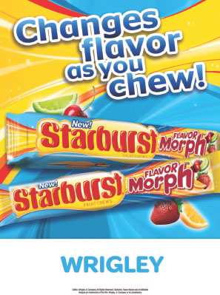
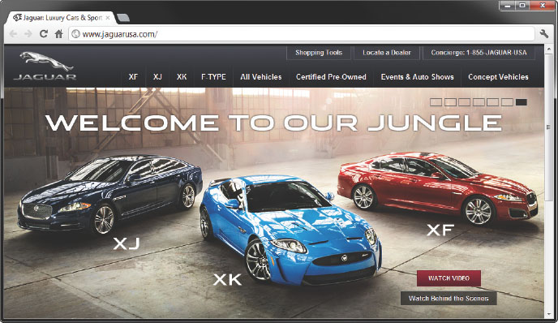
Best Channel System
Left: Source: Wm. Wrigley Jr. Company;
Right: Source: Jaguar Land Rover Automotive
Notes:
Text Caption: See below.
Summary Overview
Too much market exposure increases the total cost of marketing.
Key Issues
Starburst is a convenience product and is sold using intensive distribution.
Most members of Jaguar’s target market view the car as a heterogeneous shopping or specialty product—so the carmaker uses exclusive distribution.
Discussion Question: Can you think of more examples for intensive, extensive, and selective distribution?

Slide 19
Intensive Distribution
Click on play button to view video
Notes:
Intensive distribution is commonly used for convenience products, such as the Philips light bulbs shown in this ad.
Video Operation:
INTERNET CONNECTION REQUIRED
Clicking on the orange circle image will open a web browser and access this video. When the video is completed, you can close or minimize the browser and return to the PowerPoint slides.

Slide 20
Checking Your Knowledge
Chocolate Dreams is a manufacturer of expensive, high-quality, handmade “old style” candies that are sold through fine department stores and certain bookstores and gift shops. The ideal market exposure for products manufactured by Chocolate Dreams is:
A. intensive.
B. comprehensive.
C. exclusive.
D. extensive.
E. selective.
Notes:
Checking Your Knowledge:
Answer: E
Feedback: Selective distribution is selling through only those intermediaries who will give the product special attention. Companies commonly use selective distribution to gain some of the advantages of exclusive distribution—while still achieving fairly widespread market coverage. Chocolate Dreams is using selective distribution. The best answer selection is E.

Slide 21
Limiting Market Exposure
Producer
Vertical
Arrangements
May Be Legal
Wholesaler
Retailer 1
Retailer 2
Retailer 3
Retailer 2
Retailer 3
Horizontal Arrangements Are Illegal
Notes:
Summary Overview
Exclusive distribution is an area considered under U.S. antimonopoly laws. Courts currently focus on the potential harm to competition in answering the question, “Is limiting market exposure illegal?”
Key Issues
Horizontal arrangements among competitors are illegal.
These arrangements exist among the firms at one level of the channel.
They are considered to be collusion that reduces competition and harms customers.
→ Vertical arrangements may or not be illegal.
These arrangements exist across different levels of the channel.
Courts weigh the possible good effects of these arrangements against the possible restrictions on competition.
Discussion Question: Rolex watches are typically distributed via strict arrangements between Rolex and its “authorized dealers.” These arrangements limit the pricing latitude that dealers have in selling Rolexes. Can you create arguments that (a) this arrangement benefits customers and (b) this arrangement harms customers?
Firms should be cautious about entering into exclusive distribution arrangements. The courts can force companies to change long-standing channel structures and pay large damage awards.
→ Indicates place where slide “builds” to include the corresponding point (upon mouse click).

Slide 22
Channel Systems Can Be Complex (Exhibit 10-6)
Publisher of computer (specialty) books
General book
wholesaler
(like Ingram)
Internet book retailers
(like Amazon)
Final
consumers
(different
segments
may prefer
to buy from
different
channels)
Independent book
retailers (like campus
bookstores)
Computer
supplies &
accessories
specialty
wholesaler
Electronics superstore
chains (like Best Buy)
Bookstore chains (like
Barnes & Noble)
Direct sales from
publisher’s website
Note: Channel members may target different market segments; however, in some cases they may compete for the same customers. And the channels shown here may also compete with channels for similar books by another publisher.
Notes:
Summary Overview
Channels of distribution can involve a complex array of relationships among many organizations.
Key Issues
This exhibit shows an example of a channel arrangement for a publisher of computer books.
The book publisher must decide how to get its product to consumers. Different target markets may have different preferences for which channel they utilize.
A book publisher may choose to sell books to consumers directly from its website.
At the same time, the publisher may get their indirectly by using specialized wholesalers.
They in turn sell to online bookstores, independent books stores, and possibly electronics stores like Best Buy.
Some large retailers may buy direct and not have the wholesaler intermediary.
Multichannel distribution: occurs when a producer uses several competing channels to reach the same target market.
Discussion Question: If you were an established bookstore, how would you react to a publisher’s announcement that it planned to sell direct via a website?
Ethical decisions may be required to deal fairly with all channel members across all channels.

Slide 23

Reverse channels are important too
Source: INOBAT
Notes:
Text Caption: Disposing of batteries in the trash can be harmful to the environment. So the Swiss government created INOBAT, an organization that promotes recycling with creative promotion and an easy return bag.
Summary Overview
Environmental factors cause the development of reverse channels—channels used to retrieve products from consumers. A comprehensive distribution strategy means that reverse channels must be planned in advance.
New laws require reverse channels in some industries.
Reverse channels are sustainable and profitable.
Plan for reverse channels.

Slide 24
Entering International Markets (Exhibit 10-7)
Exporting
Licensing
Management
Contracting
Joint
Venture
Direct
Investment
Generally increasing investment, risk, and control of marketing
Notes:
Summary Overview
All the strategy decisions for Place apply whether a firm is focused on its domestic market or pursuing target customers in international markets.
Key Issues
What are the five basic ways to enter international markets?
Exporting often comes first.
Usually get started by working with intermediaries—they are typically specialists in international marketing and the target country.
Often allows a firm to test an international market with low investment of time and money.
→ Licensing is often an easy way.
The licensee in the foreign market takes most of the risk, because it must make some initial investment to get started.
If good partners are available, this can be an effective way to enter a market.
→ Management contracting sells know-how:
Relatively low risk approach to international marketing.
Can be especially important in developing nations or ones where the government is less stable.
→ Joint venture increases involvement:
Sometimes this is the only way a firm can enter a new market.
→ Direct investment involves ownership.
It is a big commitment and usually means greater risks.
→ Generally as firms move from right to left, they gain control over the marketing but they gain that at the expense of more risk and greater financial investment.

Slide 25
Key Terms
place
channel of distribution
direct marketing
discrepancy of quantity
discrepancy of assortment
regrouping activities
accumulating
bulk-breaking
sorting
assorting
traditional channel systems
channel captain
vertical marketing systems
corporate channel systems
vertical integration
administered channel systems
contractual channel systems
Notes:
Summary Overview
These are key terms you should be familiar with based upon the material in this presentation.
Key Issues
Place: Making goods and services available in the right quantities and locations--when customers want them.
Channel of distribution: Any series of firms or individuals who participate in the flow of products from producer to final user or consumer.
Direct marketing: Direct communication between a seller and an individual customer using a promotion method other than face-to-face personal selling.
Discrepancy of quantity: The difference between the quantity of products it is economical for a producer to make and the quantity final users or consumers normally want.
Discrepancy of assortment: The difference between the lines a typical producer makes and the assortment final consumers or users want.
Regrouping activities: Adjusting the quantities and/or assortments of products handled at each level in a channel of distribution.
Accumulating: Collecting products from many small producers.
Bulk‑breaking: Dividing larger quantities into smaller quantities as products get closer to the final market.
Sorting: Separating products into grades and qualities desired by different target markets.
Assorting: Putting together a variety of products to give a target market what it wants.
Traditional channel systems: A channel in which the various channel members make little or no effort to cooperate with each other.
Channel captain: A manager who helps direct the activities of a whole channel and tries to avoid‑‑or solve‑‑channel conflicts.
Vertical marketing systems: Channel systems in which the whole channel focuses on the same target market at the end of the channel.
Corporate channel systems: Corporate ownership all along the channel.
Vertical integration: Acquiring firms at different levels of channel activity.
Administered channel systems: Various channel members informally agree to cooperate with each other.
Contractual channel systems: Various channel members agree by contract to cooperate with each other.
This slide refers to boldfaced terms appearing in Chapter 10.

Slide 26
Key Terms
ideal market exposure
intensive distribution
selective distribution
exclusive distribution
multichannel distribution
reverse channels
exporting
licensing
management contracting
joint venture
direct investment
Notes:
Summary Overview
These are additional key terms.
Key Issues
Ideal market exposure: When a product is available widely enough to satisfy target customers' needs but not exceed them.
Intensive distribution: Selling a product through all responsible and suitable wholesalers or retailers who will stock and/or sell the product.
Selective distribution: Selling through only those intermediaries who will give the product special attention.
Exclusive distribution: Selling through only one intermediary in a particular geographic area.
Multichannel distribution: When a producer uses several competing channels to reach the same target market--perhaps using several intermediaries in addition to selling directly.
Reverse channels: Channels used to retrieve products that customers no longer want.
Exporting: Selling some of what the firm produces to foreign markets.
Licensing: Selling the right to use some process, trademark, patent, or other right for a fee or royalty.
Management contracting: When the seller provides only management and marketing skills – others own the production and distribution facilities.
Joint venture: A domestic firm enters into a partnership with a foreign firm.
Direct investment: When a parent firm has a division (or owns a separate subsidiary firm) in a foreign market.
This slide refers to boldfaced terms appearing in Chapter 10.

